Slide 1
Equipment and Tools for Veterinary Technicians
Types of Tools and Equipment
Diagnostic Surgical Treatment General/All Purpose General Livestock

Slide 2
Types of Tools and Equipment
Diagnostic: used to identify, detect and/or describe possible conditions
Surgical: used to preform major operations
Treatment: used to manage, heal and/or correct General/All Purpose: used in various tasks and treatments (could be considered diagnostic, surgical and treatment) General Livestock: used on livestock for specific identification and management purposes

Slide 3
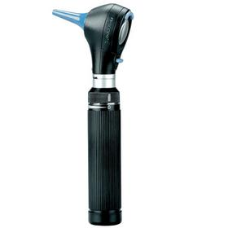
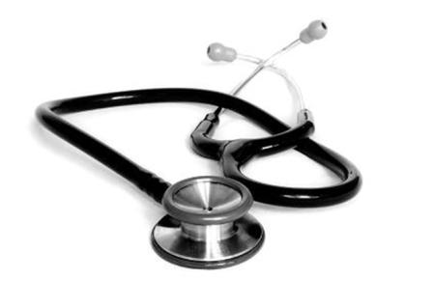
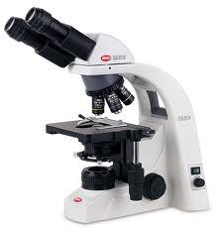
Diagnostic tools
Otoscope
Tool with small magnifying lens and light
Used to examine the ears, nose, throat and eyes
Stethoscope
Used to listen to an animal’s lungs and heart to determine if the body is functioning correctly
Microscope:
Tool containing magnifying lenses
Used to view small specimens to determine if the cells are diseased and if treatment is needed
(-scope) - instrument for inspecting or viewing

Slide 4
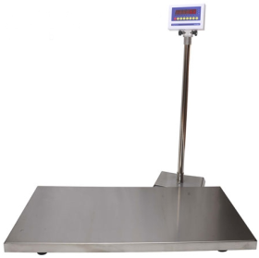
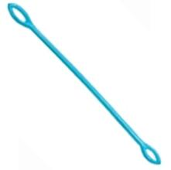
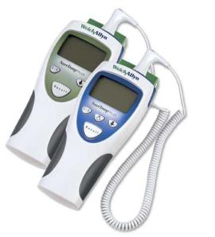
Diagnostic tools
Scale
Used to weigh an animal
Fecal Loop
Used to collect a fecal sample for a fecal exam
Thermometer
Used to take an animal’s temperature
An increase/decrease in temperature or weight can help diagnose a possible illness

Slide 5
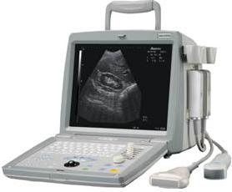
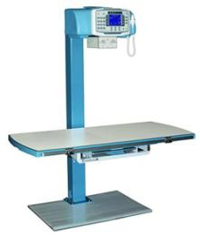
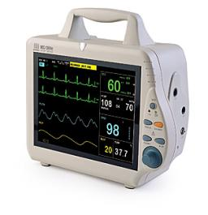
Diagnostic tools
Ultrasonography Machine
use of ultrasonic waves view internal structures
Radiography Machine
Use of x-rays to produce an image of internal structures
Electrocardiography (ECG)
Used to detect and record the small differences in electric potential caused by the heart
(-graph) - instrument that writes or records

Slide 6
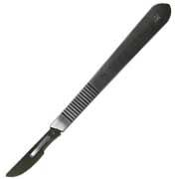
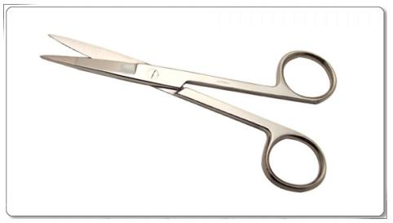
Surgical Tools
Scalpel
Small, straight knife used to cut tissue
Operating Scissors
Used to cut tissue
Have pointed sharp blade tips
Surgical tools, and the basic knowledge of how to use them, are primarily used by vet techs to assist veterinarians in surgical operations.

Slide 7
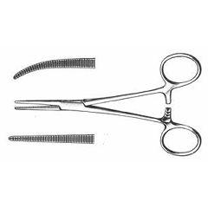
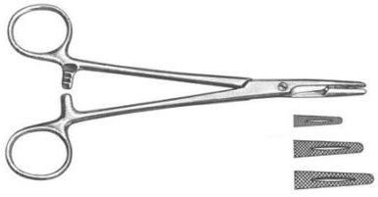
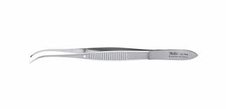
Surgical tools
Surgical Tools
Locking Surgical Forceps
Used to stop the flow of blood
Often referred to as hemostats
Locking Suture Forceps
Used to hold and guide a suture needle
Often referred to as needle holders
Thumb Forceps
Used to grasp soft tissue
There are many different varieties of each type of forceps but, they all serve a similar basic purpose.

Slide 8
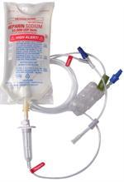
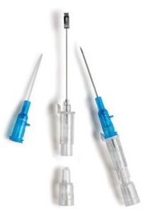
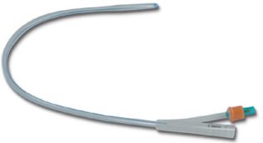
Treatment Tools
IV Drip Set
Used for fluid replacement, infusion of blood or administration of drugs into the veins
Connects to a catheter that is inserted into the vein.
Catheter
Can be used to drain fluid from the body, or to inject fluids into the body
Urinary catheter: drains urine from the bladder
IV catheter: Injects medication or other fluids into the body or veins

Slide 9
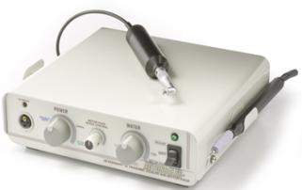
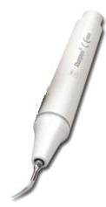
Treatment Tools
Dental Hygiene Tools:
Ultrasonic Scaler
Removes tartar with minute vibrations and washes away debris with mists of water (emits a high pitched whistling sound)
Tips are curved and rounded
Dental Polisher
Smoothens out teeth after use of scaler that usually leaves teeth with small grooves in the enamel
Tips have soft rubber cup that spins
Hand Scaler
Lacks vibrations and mist, removes tartar and plaque
Depth Probe And Explorer
Used to investigate and search to find small areas of decay in the enamel.
Tip is sharp (like a needle) and hooked
Dental mirror
Allows the technician to view hard to see places in the mouth
Vet techs are responsible for dental cleanings; much like the cleanings from your dental hygienist.

Slide 10
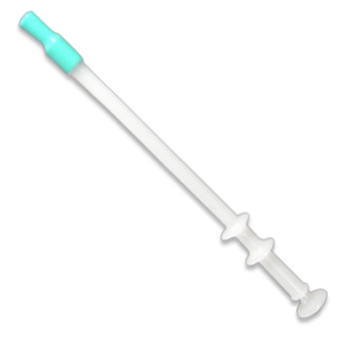
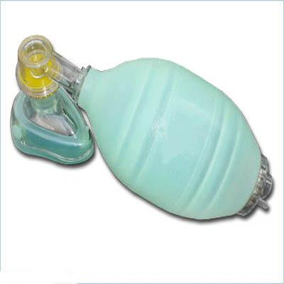
Treatment Tools
Pet Piller
Used to administer pill medications into the mouth of the animal
AMBU Bag
Used to provide positive pressure ventilation to an animal who is not breathing or who is breathing inadequately

Slide 11
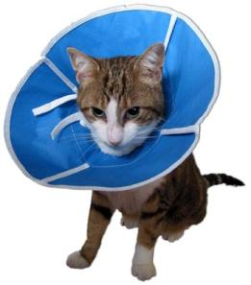
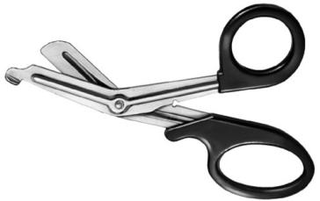
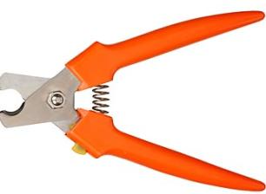
General, All-Purpose Tools
Elizabethan Collar (E-Collar)
Used to prevent animal from further damaging injuries or wounds by scratching or chewing
Bandage Scissors
Used to cut bandages and other various medical items in treatment areas
Nail Trimmer
Used to clip the nails of common species with long nails

Slide 12
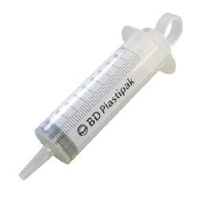
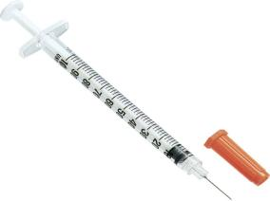
General, All-Purpose Tools
Syringes
Used to draw in a quantity of fluid for injecting the fluid into the body, for cleaning wounds, for oral administration, etc.
Some (not all) have needle tips attached to administer by injection
Syringe
Needle

Slide 13
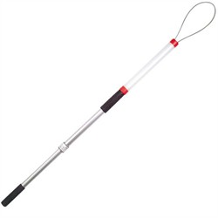
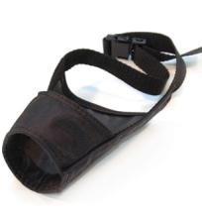
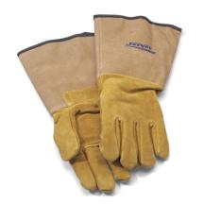
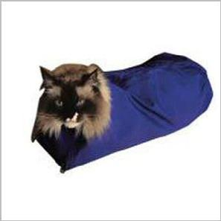
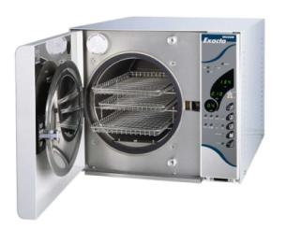
General, All-Purpose Tools
Restraint Tools
Capture Pole Or Snare
Muzzle
Restraint Bag
Gloves
Autoclave Machine
For sterilizing instruments

Slide 14
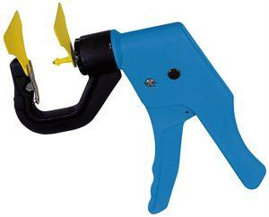
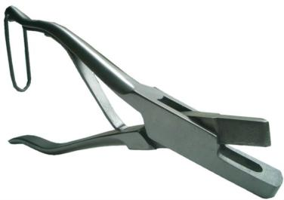
General Livestock
Identification Ear Tag Applicator
Used to apply identification tags to livestock
Ear Notcher
Used to cut V-shaped markings in the ear of pigs for identification purposes

Slide 15
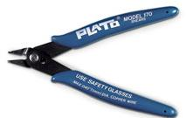
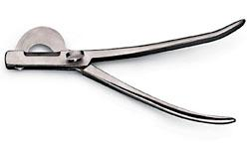
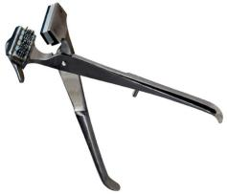
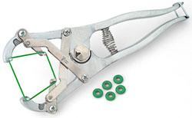
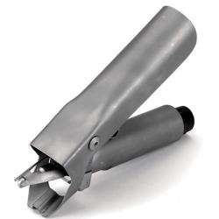
General Livestock
Pig Tooth Nipper
Removal of needle teeth to prevent harm to sow’s teats
Castrator
Used to remove the testicles in a male
Emasculator: crush and cut the spermatic cord
Burdizzo: large clamp designed to break the spermatic cord
Elastrator
Bands placed around tail for docking or testes for castration
Tail Docker
Used to remove the tail in sheep
This is to prevent wool maggots from accumulation of fecal matter under the tail

Slide 16
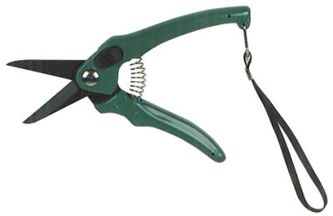
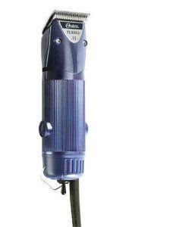
General Livestock
Balling Gun
Used as a “large animal piller” to administer medications including dewormer
Hoof Trimmer
Used to trim hooves of sheep and goats
Animal Clippers
To clip hair of a surgical site

Slide 17
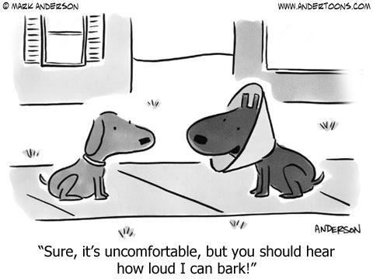

Slide 18
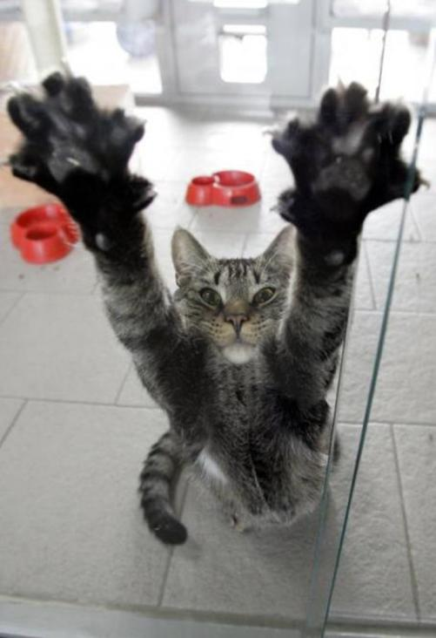
Name That Tool!

Slide 19
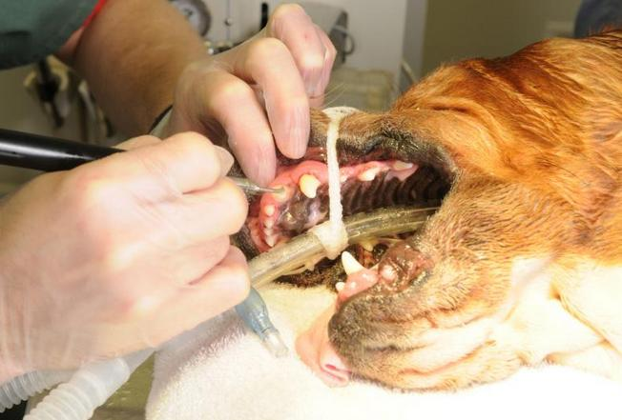
1 point
What tool(s) is being used?
Notes:
The vet tech is using an ULTRASONIC SCALER to remove plaque and tartar from this dogs teeth.
**the dog can not bite the technician because he/she has been anesthetized AKA “put to sleep”**

Slide 20
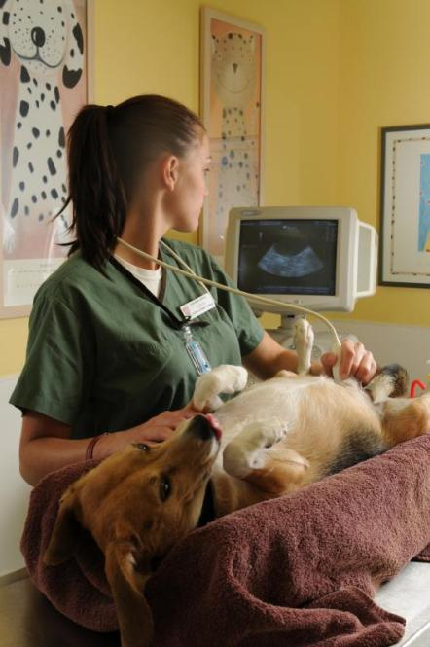
1 point
What tool(s) is being used?
Notes:
Ultrasound is being used to view the internal organs of this dog. Ultrasounds can be used to check on pregnancies as well as view other organs. such as the reproductive tract, the kidneys etc.

Slide 21
1 point
What tool(s) is being used?
Notes:
These veterinary technicians are using a radiography machine to view the internal structures of this cat. Protective clothing is worn to protect from radiation.

Slide 22
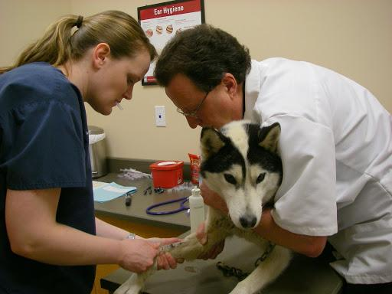
1 point
What tool(s) is being used?
Notes:
Syringe and needle used to draw blood from the dogs leg. The veterinarian is restraining the dog, while the technician is collecting the sample.

Slide 23
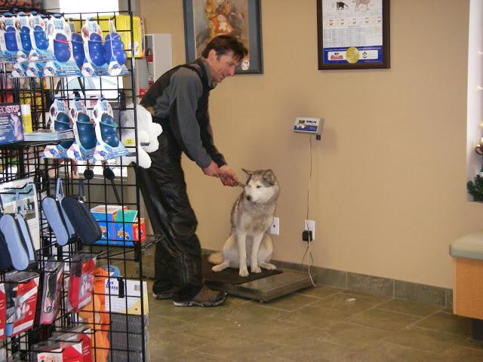
1 point
What tool(s) is being used?
Notes:
This technician is using a scale to collect the weight of the animal. Notice that only the animal is on the scale.

Slide 24
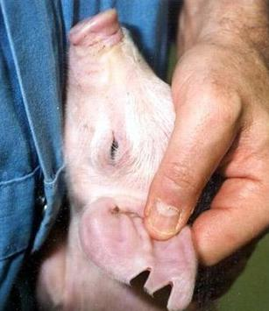
2 points
1.What tool(s) is being used?
2. Why would we use this tool?
Notes:
An ear notcher is being used to mark the piglet’s sow and litter number for identification purposes.

Slide 25
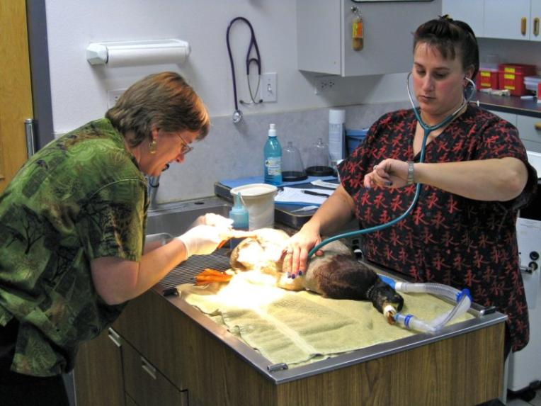
2 points
1.What tool(s) is being used?
2.Who is the Vet Technician?
Notes:
In this picture the woman in the green scrubs is the veterinarian who is doing foot surgery on this duck. The technician is using a stethoscope to keep watch of the animals pulse and breathing. This is to make sure that nothing goes wrong while the doctor completes the surgery.

Slide 26
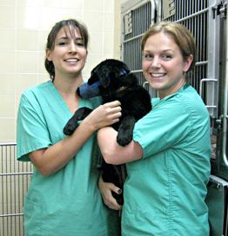
1 point
What tool(s) is being used?
Notes:
These vet techs have put a muzzle on this dog to keep him from biting. This can help keep people safe when working on animals who may become scared or defensive.

Slide 27
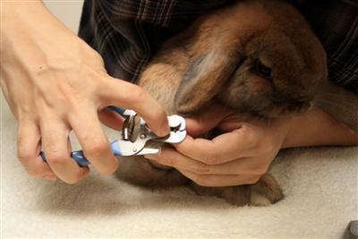
1 point
What tool(s) is being used?
Notes:
This rabbit is getting his nail trimmed with nail trimmers.

Slide 28
4 points
1.Who is the Vet Tech?
2. What vet tech tool(s) is being used?
Notes:
In this picture the veterinary technician is in the dark green scrubs behind the table. The veterinarians are wearing surgical scrubs and face masks. The vet tech is using the stethoscope and most likely keeping an eye on the IV drip. The tools seen in this picture are forceps (locking and thumb), scalpel, IV drip set, stethoscope. (because the vet tech does not have on gloves, she most likely will not handle the surgical tools. She must know what these tools are and what they are used for to prepare the surgery packs. The machine used by the vet tech to sanitize the surgery packs (tools and cloths used for surgery) is an autoclave.

Slide 29
4 points
3. What other tools are being used? 4. What machine is used to sanitize these tools?
Notes:
In this picture the veterinary technician is in the dark green scrubs behind the table. The veterinarians are wearing surgical scrubs and face masks. The vet tech is using the stethoscope and most likely keeping an eye on the IV drip. The tools seen in this picture are forceps (locking and thumb), scalpel, IV drip set, stethoscope. (because the vet tech does not have on gloves, she most likely will not handle the surgical tools. She must know what these tools are and what they are used for to prepare the surgery packs. The machine used by the vet tech to sanitize the surgery packs (tools and cloths used for surgery) is an autoclave.

